Slide 1
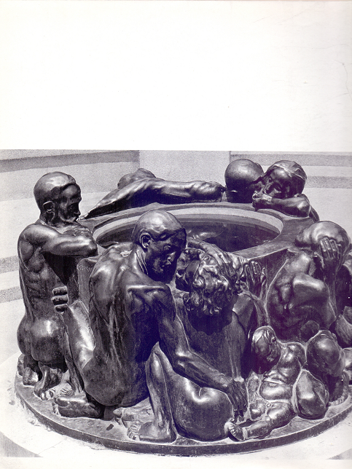
Cultures of South-Eastern Europe 2 November 23, 2015
National Figures of Heroes in the Statuary of Ivan Meštrović and the Epic Cycle Croatian kings of Vladimir Nazor
The Well of Life, 1905

Slide 2
IVAN MEŠTROVIĆ Autoportrait, bronze, 1892

Slide 3
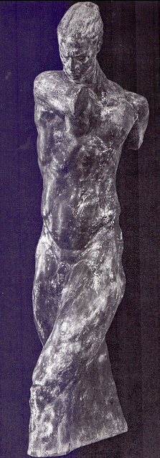
MEŠTROVIĆ’S KOSOVO CYCLE 1. Miloš Obilić, bronze, 1909

Slide 4
2. Princ Marko on his horse Šarac, bronze, 1910

Slide 5
3. Kosovo Girl, marble, 1909

Slide 6
4. Blind Minstrel, bronze, 1908

Slide 7
5. Memory, marble, 1908 (formerly named Vukosava)

Slide 8
6. A Widow, bronze, 1907

Slide 9
7. Torso of Banović Strahinja, marble, 1908

Slide 10
8. Srđa Zlopogleđa, bronze, 1908

Slide 11
9. My Mother, bronze, 1909

Slide 12
Statue of the Victor , a figure from the Monument of Freedom, bronze, 14 meters of height, placed in Kalemegdan Park in Belgrade in 1924

Slide 13
THE VIDOVDAN TEMPLE, model, wood, 1912

Slide 15
THE VIDOVDAN TEMPLE – caryatids, marble, 1912

Slide 16
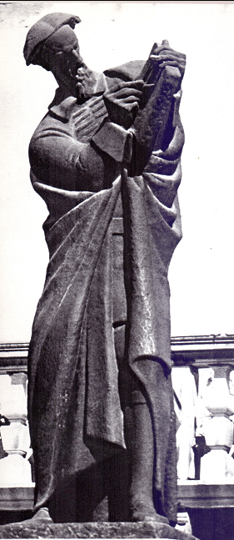
Marko Marulić, bronze, 1924

Slide 17
Ban Petar Berislavić, stone, 1933

Slide 18
The Monument of Grgur Ninski, bronze, 1927

Slide 19
The Monument of Josip Juraj Strossmayer, bronze, 1925-1926

Slide 20
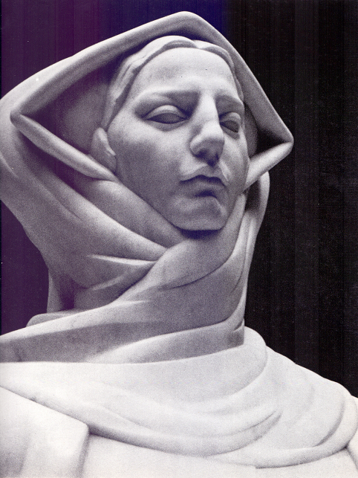
The History of Croats, marble, 1932

Slide 21
The Monument of Andrija Kačić Miošić in his native place Brist

